Slide 1


WELCOME TO D213
Advanced Data Analytics - Task 1
Disclaimer
This PowerPoint is not an official WGU resource. It is not even required. It is my rough
note for the Cohort Webinar. Not intended for publication. It is a WIP and intended for
the students who have asked for it in the form it is. Any questions should be directed to:
Dr. Festus Elleh
Course Instructor, MSDA
festus.elleh@wgu.edu
385-428-3501
Thank you.

Slide 2
Time Series Analysis
Advanced Data Analytics Course prepares students for career-long growth in steadily advancing tools and techniques and provides emerging concepts in data analysis.
This course hones the mental and theoretical flexibility that will be required of analysts in the coming decades while grounding their approach firmly in ethical and organizational-need-focused practice.
Time series analysis involves analyzing a sequence of data points collected over an interval of time.
Topics include:
Stationarity
ARIMA
Model Evaluation
Autocorrelation,
ACF/PACF
Spectral Density
Model Evaluation
Train/Test Split
Decomposition
Forecasting

Slide 3

R - Resources
Time Series in R. – Data Camp
ARIMA models in R. – Data Camp
Introduction to Natural Language Processing in R
Text Mining with Bag-of-Words in R
Sentiment Analysis in R
Instructor-Made Videos – in Course Announcements
Cohort PowerPoint – Course Chatter & Course Announcement
How to install Tensorflow in R – Course Announcement.
Python - Resources
Time Series Analysis in Python – Datacamp
Introduction to Deep Learning in Python
3. TS in Python 5 Chapters on this link:
https://app.datacamp.com/learn/courses/time-series-analysis-in-python
4. Introduction to TensorFlow in Python
5. Building Chatbots in Python
Instructor-Made Videos – in Course Announcements
Cohort PowerPoint – Course Chatter & Course Announcement
How to install Tensorflow in Python – Course Announcement
Instructor-provided resources are in the Course Announcement

Slide 4
Cohort Webinar Reminder!!!
Don’t forget to join the Cohort Webinar for D213-Advanced Data Analytics today Sunday. The session holds on the 3rd Sunday of every month. Time: 1:00 PM MDT, 2:00 PM CST, and 3:00 PM EST.
Links:
https://srm.my.salesforce.com/apex/CohortLiveEvent?id=a2w3x00000GWd2Z https://srm.my.salesforce.com/apex/CohortLiveEvent?cohortId=a2y3x000003f6DP
If prompted:
Session Number: 120 095 4238
Session Password: d213
If you have not registered, please do so on the D213 Course Homepage.
Under Cohort sign-up:
· Click on EXPLORE COHORT OFFERINGS
· Click on View Details & Enroll
· Check the box Dec 7, 2023
· Click ENROLL
See you soon!
Course Cohort
Webinar

Slide 5
Is a Time Series Supervised or Unsupervised?
Time Series can be either supervised or unsupervised, depending on the context.
In supervised learning, the data used to train a model includes labeled input-output pairs. For example, in a time series forecasting task, the input data may consist of past values of a given variable, and the output data may consist of future values of the same variable.
The goal of supervised learning is to train a model that can make accurate predictions based on the input data.
In unsupervised learning, the data used to train a model does not include labeled input-output pairs.
For example, in a time series clustering task, the input data may consist of past values of a given variable, and the goal of unsupervised learning is to discover patterns or segments in the data that can be used to group similar observations together.

Slide 6
Can Arima model be used on a non-stationary data?
“In the realm of data, forecasting non-stationary time series is like navigating a river’s ever-changing currents, where adaptability and precision are the compass and the map.” - Gomede, E. (0ct 2023). Forecasting Non-Stationary Time Series
Yes, ARIMA can be modeled on A non-stationary data.
ARIMA Models are widely used for non-stationary time series. ARIMA models involve differencing the data to make it stationary and then modeling it using autoregressive and moving average components.
Should time series data be stationary to use ARIMA model?
No, the I-letter stands for the procedure part, which makes stationary time series out of your non-stationary one. This procedure is called "differencing". However, if you want to use ARMA(p, q) straightforward, then your time series BETTER be stationary.
Non-Stationary – means TS statistical properties (mean, variance, trend, and autocorrelation) change over time.
Stationary – means its statistical properties do not change over time
https://medium.com/@evertongomede/forecasting-non-stationary-time-series-03b638a7cd50#:~:text=ARIMA%20Models%3A%20AutoRegressive%20Integrated%20Moving,autoregressive%20and%20moving%20average%20components.

Slide 7
Types of Time Series Model
The following models are used in forecasting Time Series data.
ARMA
ARIMA
Exponential Smoothing
ARMA: Used if the series is stationary. Used in econometric analysis. The advantage is that it has more degrees of freedom, with a greater latitude in generating spectral shapes with sharp maxima and minima.
ARIMA: Predicts how something will act in the future based on past performance. It aim to describe the autocorrelations in the data. The advantage is in its flexibility to capture various types of patterns and behaviors in the data, such as seasonality, cyclicality, or trends. But it is generally inadequate for long-term forecasting, such as more than six months ahead, because it uses past data and parameters that are influenced by human thinking. ARIMA can be seasonal or non-seasonal depending on the type of data (Brockwell, P. J., & Davis, R. A. (2016).
SARIMA is Seasonal ARIMA, meaning it is like ARIMA but for seasonal datasets.
SARIMAX is an updated version of ARIMA with seasonal effects and eXogenous factors, meaning it is like ARIMA/SARIMA but with independent variables.
A nonseasonal ARIMA model is classified as an "ARIMA(p, d, q)" model, where: p is the number of autoregressive terms, d is the number of nonseasonal differences needed for stationarity, and. q is the number of lagged forecast errors in the prediction equation.

Slide 8
Types of Time Series Model Cont’d
In a seasonal ARIMA model, seasonal AR and MA terms predict using data values and errors at times with lags that are multiples of S (the span of the seasonality).
Arima parameters:
P – is the lag order, i.e., no of observations in the model
D - is the differencing order, i.e., no of times the raw observations are differenced.
Q – is the moving average order, i.e., the size of the moving average window.
Exponential Smoothing: They use weighted averages of past observations to forecast new values. The idea is to give more importance to recent values in the series. Thus, as observations get older in time, the importance of these values get exponentially smaller.
It is based on a description of the trend and seasonality in the data offering simplicity for short to medium forecasts. (Brown, 1959; Holt, 1957; Winters, 1960). See details at the reference section.
https://www.investopedia.com/terms/a/autoregressive-integrated-moving-average-arima.asp#:~:text=The%20ARIMA%20model%20is%20used,future%20based%20on%20past%20performance.
https://otexts.com/fpp2/expsmooth.html

Slide 9
Should I select ARIMA parameters based on training data or the whole data?
The purpose of splitting dataset into a training and testing set is to simulate real-world scenarios where you train your model on historical data and evaluate its performance on unseen future data.
Create ARIMA with the training data in accordance with real-world scenario.
Should I predict ARIMA on training data or the whole data?
Predict on the training data so you can compare to the training set.
How do I know if my ARIMA model is good?
1. ACF of the residuals. For a good model, all autocorrelations for the residual series should be non-significant. If this isn't the case, you need to try a different model.
2. Box-Pierce (Ljung) Test. The tests shows possible residual autocorrelation at various lags.

Slide 10
SUMMARY STEPS IN CREATING AND PREDICTING TIMES SERIES WITH ARIMA
Split the non-stationary data into training and test sets.
Use Auto Arima to find the best Model. (Model with the lowest AIC).
Build Arima Model with the Training Data.
Fit the Model to the Training Data.
Print mean absolute error (MAE) and create 4 diagnostic plots.
Predict with the Training data.
Show visualization (Plot the graphs).
Save the model.
Reload the model.
Evaluate with the test set.
Plot the graph of the training forecast compared with the test forecast.

Slide 11
Time Series Analysis Using ARIMA MODEL
SUMMARY STEPS TO IMPLEMENT TASK 1
Clean the original data.
Import the initial dataset into a data frame.
Difference the data set to coerce stationarity and save it.
Perform spectral density to see the periodicities/cyclicality in the data.
Perform ACF/PACF on the dataset to confirm stationarity.
Decompose the original (non-diffed) data set.
Plot the trend, seasonal, and residual components individually.
Split the original clean data into training and test sets (80% training and 20% test).
Perform auto_arima to find the best Model (Model with the lowest AIC).
Create Arima model with the training data.
Print mean absolute error (MAE) and create 4 diagnostic plots
Perform forecast on the training set and compare to the test set.
Save the model.
Reload the model
Evaluate with the test set.
Data Set: Churn or Medical data set and its associated data dictionary

Slide 12
Task Breakdown Structure (TBS)
S/N | Summary Tasks | Work Package Breakdown
1 | Explore data set | Examine the data structure. Summarize the data using descriptive statistics. Plot preliminary data for visual understanding.
2 | Clean data set | Check for missing and null values or duplicates. Convert data frame into time series object. Index as appropriate
3 | Evaluate stationarity | Use KPSS or ADFuller test to determine if the data is stationary. If not, calculate the number of differencing required to coerce stationarity.
4 | Prepare data for analysis | Split the data into training and testing data sets. Export the clean data.
5 | Analyze the prepared data | Decompose the time series data. Detect any trend and seasonal patterns. Examine ACF/PACF to get an idea of the appropriate p and q parameters. Review spectral density to determine periodicities and strength of the occurrences Confirm the lack of trends in the residual plot.
6 | Build and Predict ARIMA model | Use Auto Arima to find the best Model. (Model with the lowest AIC) Build Arima Model with the Training Data Fit the Model to the Training Data Predict with the training data and compare to the test set
7 | Summarize findings | Document results from this data analysis. Interpret results in the context of the research question. Provide actionable recommendations.

Slide 13
REQUIREMENTS
Part I: Research Question
A. Describe the purpose of this data analysis by doing the following:
1. Summarize one research question that is relevant to a real-world organizational situation captured in the selected data set and that you will answer using time series modeling techniques.
2. Define the objectives or goals of the data analysis. Ensure that your objectives or goals are reasonable within the scope of the scenario and are represented in the available data.
Part II: Method Justification
B. Summarize the assumptions of a time series model including stationarity and autocorrelated data.
Part III: Data Preparation
C. Summarize the data cleaning process by doing the following:
1. Provide a line graph visualizing the realization of the time series.
2. Describe the time step formatting of the realization, including any gaps in measurement and the length of the sequence.
3. Evaluate the stationarity of the time series.
4. Explain the steps used to prepare the data for analysis, including the training and test set split.
5. Provide a copy of the cleaned dataset.

Slide 14
Part IV: Model Identification and Analysis
D. Analyze the time series dataset by doing the following:
1. Report the annotated findings with visualizations of your data analysis, including the following elements:
• the presence or lack of a seasonal component – non-stationary data
• trends
• autocorrelation function
• spectral density
• the decomposed time series
• confirmation of the lack of trends in the residuals of the decomposed series
2. Identify an autoregressive integrated moving average (ARIMA) model that takes into account the observed trend and seasonality of the time series data.
3. Perform a forecast using the derived ARIMA model.
4. Provide the output and calculations of the analysis you performed.
5. Provide the code used to support the implementation of the time series model.
D1 on Non-Stationary Dataset.
https://jmstipanowich.medium.com/how-to-easily-decompose-a-time-series-and-check-its-stationarity-using-statsmodels-e69f6f688df8
D2 and D3 on Training Dataset
Statsmodels in Python can easily decompose the non-stationary aspects of a time series for better understanding and modeling and provide quick checks to when a time series reaches a point of being stationary enough for modeling purposes.

Slide 15
Part V: Data Summary and Implications
E. Summarize your findings and assumptions, including the following points:
1. Discuss the results of your data analysis, including the following:
• the selection of an ARIMA model
• the prediction interval of the forecast
• a justification of the forecast length
• the model evaluation procedure and error metric
2. Provide an annotated visualization of the forecast of the final model compared to the test set.
3. Recommend a course of action based on your results.
Part VI: Reporting
F. Create your report from part E using an industry-relevant interactive development environment (e.g., an R Markdown document, a Jupyter Notebook, etc.). Include a PDF or HTML document of your executed notebook presentation.
G. List the web sources used to acquire data or segments of third-party code to support the application.
H. Acknowledge sources, using in-text citations and references, for content that is quoted, paraphrased, or summarized.
I. Demonstrate professional communication in the content and presentation of your submission.

Slide 16
Day and DateTime Formats
Indexing your Date Column if you are using a Day format
## X=data.values
X=data.Day
y=data.Revenue
# add index
data.set_index('Day', inplace=True)
#check datatype of index
Data.index
Then to display:
data.hist()
rcParams['figure.figsize'] = 12, 7
pyplot.show()
# Convert Day to a DateTime format if using the Date format.
Python Code Example:
df['Date'] = (pd.date_range(start=datetime(2019, 1, 1),
periods=df.shape[0], freq='24H'))
# Set the Date as an index
df.set_index('Date',inplace=True)
df
# Explore the data by Visualizing the data.
Python Code Example
plt.figure(figsize=(10,5))
plt.plot(df.Revenue)
plt.title('Revenue Chart')
plt.xlabel('Day')
plt.ylabel('Revenue in million dollars')
plt.grid(True)
plt.show()

Slide 17
Expectations and Clarifications of the Requirements
Part I: Research Question
A. Describe the purpose of this data analysis by doing the following:
A1. Summarize one research question that is relevant to a real-world organizational situation captured in the selected data set and that you will answer using time series modeling techniques.
Ex 1. What should be our revenue forecast for the upcoming year?
Ex 2. Is it possible to forecast the daily revenue of the company for the next quarter so that the company can plan a project for network capacity expansions for its customers?
Ex 3. Using the previous two years of data, are there any patterns present that can predict the
revenue produced by the hospital for the next quarter?
Ex 4. Is it possible to discern significant trends in our hospital network’s revenue over the past two years using time series analysis?

Slide 18
A2. Objectives and Goals
Define the objectives or goals of the data analysis. Ensure that your objectives or goals are reasonable within the scope of the scenario and are represented in the available data.
Ex 1. To build a predictive model that will forecast future revenue, by analyzing the revenue by day for the past two years to identify overall trends, seasonality, and other factors.
Ex 2. To use time series modeling to forecast the daily revenue of the company for the next quarter.
Ex 3. To identify significant patterns in revenue that can help us determine when readmissions occur within our network of hospitals. The insights from time-series revenue information will help us determine whether readmission rates are correlated with trends in daily revenue.

Slide 19
Part II: Method Justification - Summary of Assumptions
B. Summarize the assumptions of a time series model including stationarity and autocorrelated data.
Assumptions of a Time Series Model - ARIMA
1. Stationarity
The data will be stationary. This means that the properties of the time series are consistent over the time frame analyzed. The mean, variance, and autocorrelation structure of this data are consistent over the time delta (Sematech, Sangarshanan, 2018).
The series has zero trends, it is not growing or shrinking (Datacamp, n.d).
The error term is randomly distributed. The error in time series analysis is assumed to be uncorrelated.
There should be no outliers in the series. Outliers could lead to inaccurate results (Statistics Solutions, 2021).
The residuals aren’t autocorrelated.
Stationarity can be tested using the Augmented Dickey-Fuller (ADF) test or the KPSS. The null hypothesis is that the time series data has a unit root, or it is non-stationary, and rejection of the null hypothesis means the data is considered stationary.

Slide 20
B. Cont’d
2. Autocorrelation
Another assumption of ARIMA is that the time-series data points will not be highly correlated with past observations over time (Dobbins et al., 2021). Autocorrelation is a measure of the correlation of a current data point value with previous data point values (Builtin, n.d.). If data has high autocorrelation, then it is likely that previous values, or lags, will be helpful in predicting current and future values (MachineLearningPlus, n.d.).
Autocorrelation is a mathematical representation of the degree of similarity between a given time series
and a lagged version of itself over successive time intervals (Educative, n.d.; Dotis-Georgiou, 2021).
Sample Python Code:
plot_acf(df_stationary, lags=30, zero=False, ax=ax1)
plot_pacf(df_stationary, lags=30, zero=False, ax=ax2) ## Plot the PACF of df
plt.show()
Sample R Code:
acf(ddchurn_ts)
acf2(ddchurn_ts)
You will see that PACF cuts off after lag p(1) and ACF tails off, indicating AR(1) model.
Source: https://towardsdatascience.com/identifying-ar-and-ma-terms-using-acf-and-pacf-plots-in-time-series-forecasting-ccb9fd073db8

Slide 21
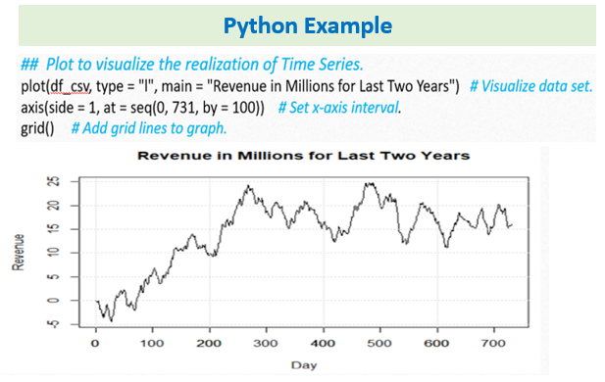
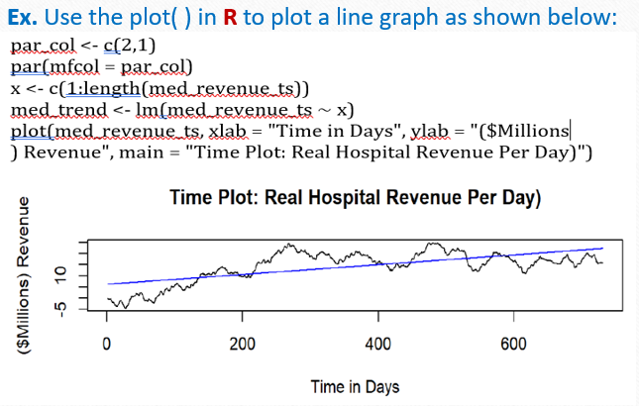
Part III: Data Preparation
C. Summarize the data cleaning process by doing the following: 1-5.
C1. Provide a line graph visualizing the realization of the time series.
Usually, Time Series analysis may start with importing the dataset and EDA. You may need to open first a series of R or Python packages that allow the use of functions for statistical analysis and ARIMA modeling. Plotting the line graph provides visualization.

Slide 22
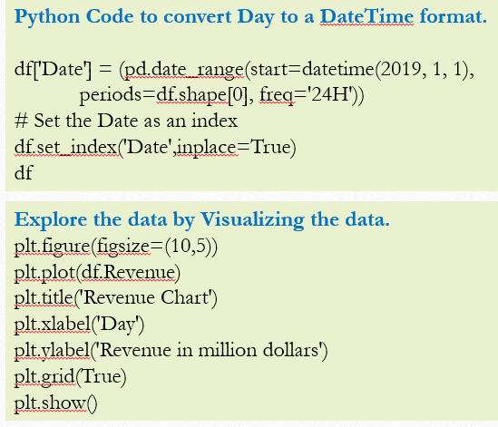
C2. Describe the time step formatting of the realization, including any gaps in measurement and the length of the sequence.
This is to examine for any gaps in measurement. The time step is a day, and the length of the series is 731 days. You have 2 years (731 days) where each day correlates to a unique day with no gaps or days of absent data.
To prepare the data set for time series analysis, the data set will be examined for any gaps in measurement and then converted into a time series object. You may need to show the code that you used to convert the data to Time Series Object. One line of code to verify the data frame, another line of code to convert to a vector, a code to verify the vector, a line of code to convert to Time Series, a line of code to verify Time Series Object and a line of code to plot the time series.
R code to convert the Data to Time Series Object
is.data.frame(df_csv) # Verify data frame
df_vector <- df_csv[['Revenue']] # Convert to vector
is.vector(df_vector) # Verify vector
time_series <- ts(df_vector, frequency = 731/24) # Convert to time series
is.ts(time_series) # Verify time series object
autoplot(time_series, main = "Time Series", ylab = "Revenue in Millions", xlab = "Months") # Plot time series as shown below.

Slide 23
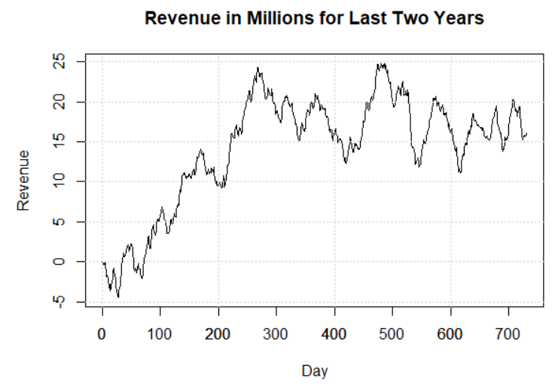
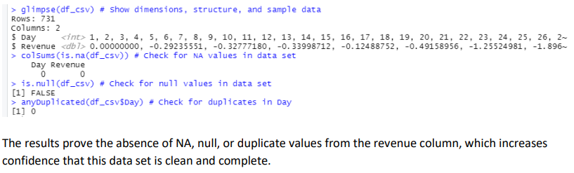
You will also need to clean the data for Time Step Formatting.
You will write a code to show the dimension, structure, and sample data, a code that checks for NA values, null values, and duplicates.
It is a good idea to show the codes. You can even plot the Time Series data for the evaluator to see.
# R Code to clean the Data for Time Step Formatting
Line 1: glimpse(df_csv) # Show dimensions, structure, and sample data
Line 2: colSums(is.na(df_csv)) # Check for NA values in data set
Line 3: is.null(df_csv) # Check for null values in data set
Line 4: anyDuplicated(df_csv$Day) # Check for duplicates in Day

Slide 24
C3. Evaluate the stationarity of the time series.
Stationarity of the time series data should be established prior to modeling. You can use the Kwiatkowski-PhillipsSchmidt-Shin (KPSS) test or ADFuller test.
Evaluating Stationarity in R using the Kwiatkowski-PhillipsSchmidt-Shin (KPSS) test.
Kwiatkowski-PhillipsSchmidt-Shin (KPSS) test is a type of unit root test that tests for the stationarity of a time series around a deterministic trend (Prabhakaran, 2019). Example below:
time_series %>% ur.kpss() %>% summary() # KPSS test # Non-stationary
time_series %>% diff() %>% ur.kpss() %>% summary() # Differencing # Stationary
ndiffs(time_series) # Time series requires 1 round of differencing to coerce stationarity
You will get an output that shows you the result of the test. There you will evaluate if your null hypothesis will be accepted or rejected based on the test statistic or p-Value.
You can diff the data by any of these methods
Diff () or shift() – first order of differencing
Diff(2) – second order of differencing
Diff(diff()) – multiple order of differencing

Slide 25
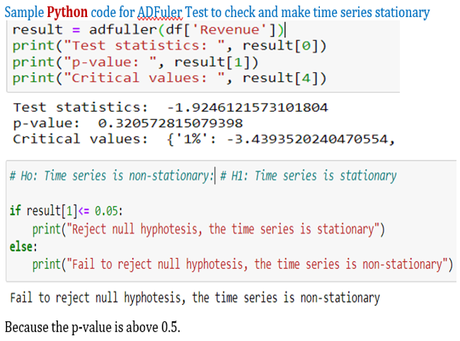
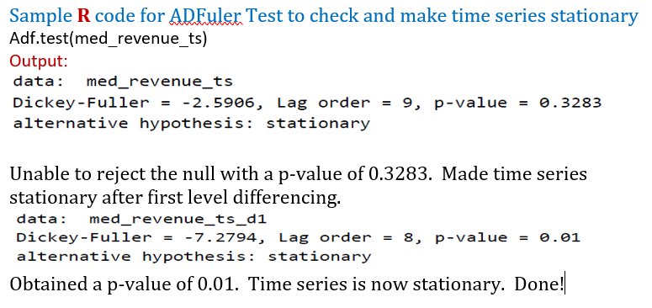
C3 Cont’d
ADFuller Test. Evaluate the stationarity of your time series data with Augmented Dickey-Fuller (ADFuler) test. If it is not stationary, then make it so. The reason is that, to model (ARIMA) a time series, it must be stationary. We explained stationarity earlier on. For ADFuller test, a p-value of <= 0.05, allow me to reject the null hypothesis.

Slide 26
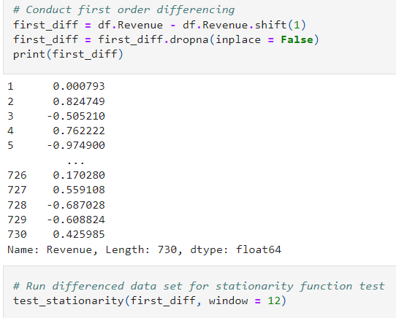
Making TM stationary:
Differencing: Is a method of transforming time series to remove temporal dependence like trends and
seasonality and helps stabilize the mean of the time series. It computes the differences between consecutive observations by subtracting the previous observation from the current observation (Brownlee, 2020). In this time series data, only one order of difference is required to coerce stationarity. Differencing can help stabilize the mean of a time series by removing changes in the level of a time series, and therefore eliminating (or reducing) trend and seasonality.
Python Code to Diff the data

Slide 27
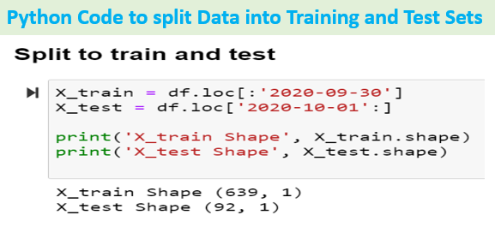
C4. Explain the steps used to prepare the data for analysis, including the training and test set split.
Import the data from CSV into pandas data frame (Python); OR
Read the data set into RStudio using the read.csv command
Perform EDA to visualize and identify null values (731, 1).
You can mention so at this point if you convert the Day column to a Date column, some students like the date/time format because time series model like a date structure.
Test time series to detect non-stationarity and coerce stationarity with differencing or ACF.
Split the date into training and test sets. The rule of thumb for splitting data is 80/20, 70/30 or 75/25 Training/Test. And 60/20/20 or 50/25/25 Train/Validation/Test in the case of hold-out.
R Code to split Data into Training and Test Sets
• split <- ts_split(time_series, sample.out = 183) # Partition time series 75/25
• training <- split$train # Assign training data
• testing <- split$test # Assign testing data
• length(time_series) # Count transactions in time series
• length(training) # Count data points in training data
• length(testing) # Count data points in testing data

Slide 28
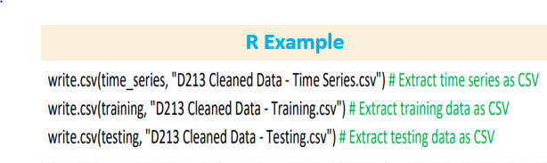
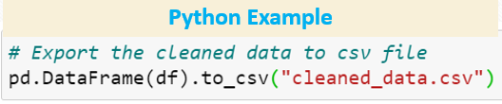
Fitting and Evaluating the Model Performance
Training set is used to fit the model parameters.
The validation set is used to tune model hyperparameters.
The test set is used to evaluate the model performance on an unseen data.
C5. Provide a copy of the cleaned dataset. You need to export your training and test sets to csv and include with your submitted report.

Slide 29
Model Evaluation
Model Evaluation is an integral part of the model development process that helps to find the best model that represents our data and how well the chosen model will work in the future.
Two Methods in Data Science: Hold-Out and Cross-Validation.
Hold-Out randomly divides the dataset into three subsets:
Training set is used to build predictive models.
Validation set is used to assess the performance of model built in the training phase. It provides a test platform for fine tuning model's parameters and selecting the best-performing model. Not all modeling algorithms need a validation set.
Test set is used to assess the likely future performance of a model. If a model fit to the training set much better than it fits the test set, overfitting is probably the cause.
Cross-Validation – used when data is limited
K-fold cross-validation divides the data into k subsets of equal size.
We build models k times, each time leaving out one of the subsets from training and use it as the test set.
If k equals the sample size, this is called "leave-one-out".
https://www.saedsayad.com/model_evaluation.htm

Slide 30
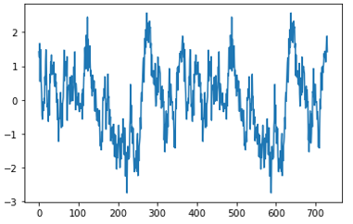
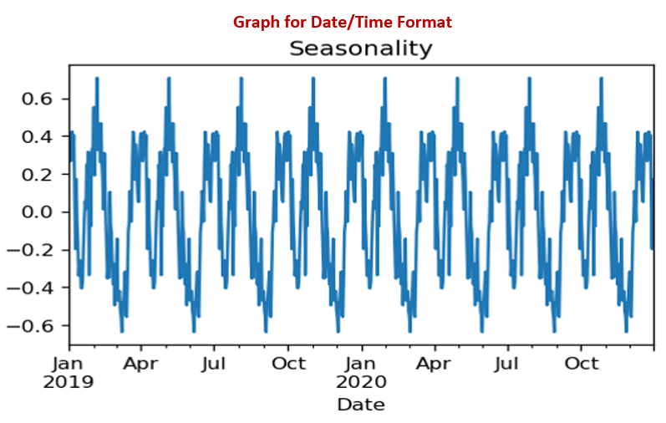
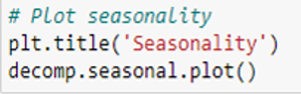
Part IV: Model Identification and Analysis
D. Analyze the time series dataset by doing the following:
1. Report the annotated findings with visualizations of your data analysis, including the following elements: Annotation means adding notes, legends, captions, and labels to your graphs and charts to help explain them.
D1a. Seasonality: the presence or lack of a seasonal component: Seasonality refers to cycles that repeat regularly over time as shown below. That circle can be daily, weekly, monthly, quarterly, yearly, etc. The cycle structure is considered seasonal if it repeats at the same frequency. Plot and display time series showing seasonal component.
The x-axis captures the chronological progression (time) within each season, while the y-axis showcases the variable of interest.

Slide 31
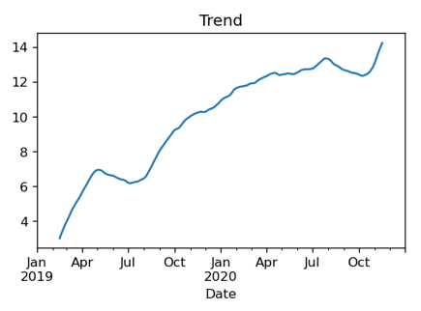
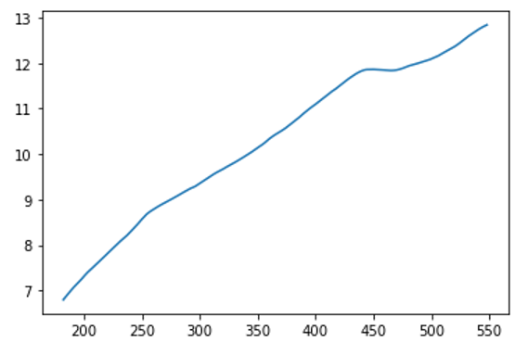
D1b. Trends. The trend of a time series can be determined by analyzing the overall direction of the series over a period. It can be upward or downward.
Plot and display time series showing Trend component
Result.trend.plot()

Slide 32
Seasonality and Trend Plots in R
Seasonality: Using decomposition to detect seasonality in the original dataset
tsdata <- ts(data$Revenue, frequency = 30) ## Seasonality has 30 days of cyclicality or frequency (repeating pattern for a 30-day fixed period).
The x-axis captures the chronological progression (time) within each season, while the y-axis showcases the variable of interest.
dataDecomp <- decompose(tsdata)
plot(dataDecomp$seasonal)
Trend: Using decomposition to detect trends in the original dataset
tsdata <- ts(data$Revenue, frequency = 30)
dataDecomp <- decompose(tsdata)
plot(dataDecomp$trend)

Slide 33
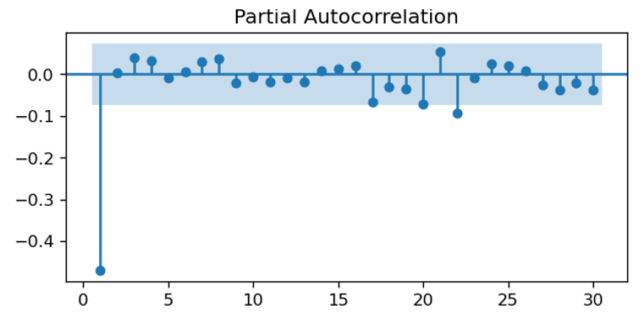
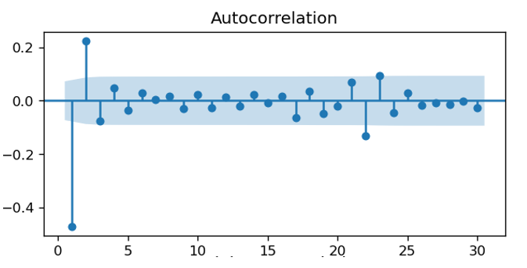
D1c. Auto Correlation Function - ACF
ACF describes the direct relationship between an observation and its given lag. It shows how the data is correlating across periods.
A value between 0 and 1, represents a positive correlation, and negative values would denote that the data is not correlated.
The autocorrelation function at lag-1 is the correlation between a time series and the same time series offset by one step.
Partial Auto Correlation Function - PACF
PACF: describes the direct relationship between an observation and its given lag. It shows the absolute correlation of a series and its lag while ignoring any correlation influences from the intermediary lags (Datacamp, n.d).
ACF and PACF gives an idea of the p & q parameters. The plot shows ACF values at increasing/decreasing lags. If these values are small and lie inside the blue shaded region, then they are not statistically significant. The ACF Plot can help you determine the stationarity of TM. For a stationary TS, the ACF will drop to zero quickly, while the ACF of non-stationary data decreases slowly.

Slide 34
Notes:
ACF and PACF are tools to help determine the P and Q values of the ARIMA model.
ACF and PACF help determine the order of the model; ACF determines the MA, while PACF determines the AR.
ACF plot is also used to determine if the time series data is stationary or not.
The autocorrelations could be applied to the differenced data and the original data for comparison.
If the ACF is constant, then the data is not stationary. If the ACF is not constant, then the data is stationary.
The residuals of the decomposition should be flat.
An assessment of the recurrent timescale of the seasonality is relevant for determining appropriate parameters for the ARIMA model.
ACF shows the type of model that should be used.
AR terms (model) will be used if the ACF plot decays toward zero.
MA terms (model) will be used if the PACF plot gradually drops.
If your ACF and PACF display up to only 10 lags, that is considered substantially too short.
https://otexts.com/fpp2/stationarity.html
https://towardsdatascience.com/interpreting-acf-and-pacf-plots-for-time-series-forecasting-af0d6db4061c

Slide 35
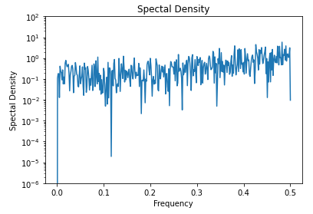
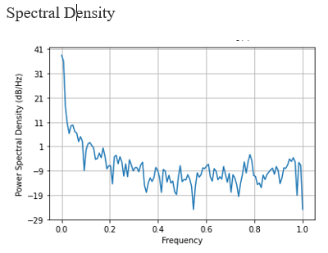
D1d. Spectral Density
Spectra Density is a graph that shows frequencies related to the autocovariance time domain. It represents the frequency domain of a time series and is directly related to the autocovariance time domain. The “frequency” is the number of observations before the seasonal pattern repeats. Autocovariance is simply the covariance between two elements in the series.
A spectral density plot, or periodogram, provides information about the relative strength of the different occurrences to help explain the variation found within a time series data set.
Stationary Data Non-Stationary Data
PennState: https://online.stat.psu.edu/stat510/lesson/12/12.1
https://www.rdocumentation.org/packages/stats/versions/3.6.2/topics/spectrum
SD in Python: https://docs.scipy.org/doc/scipy/reference/generated/scipy.signal.periodogram.html
SD in R: https://stat.ethz.ch/R-manual/R-devel/library/stats/html/spec.ar.html

Slide 36
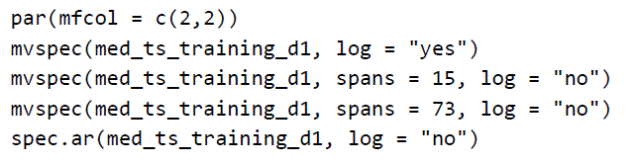
Sample Python Code for Spectral density
Sample R Code for Spectral Density
f, Pxx_den = signal.periodogram(df_stationary['Revenue'])
plt.semilogy(f, Pxx_den)
plt.ylim([1e-6, 1e2])
plt.title('Spectal Density')
plt.xlabel('Frequency')
plt.ylabel('Spectal Density')
plt.show()
spectrum(time_series) # Visualize spectral density.
Why Spectral Density?
Time Series sometimes shows periodic behavior which can be difficult to understand. So, you do Spectral analysis to discover underlying periodicities.
It helps to understand the cyclicality in the data.
You do so by transforming the data from the time domain to the frequency domain.
Periodicity is the fact of something happening at regularly-spaced periods of time.
An example of periodicity is the full moon happening every 29.5 days.

Slide 37
Interpretation of Spectral Density
The spikes or signals on the spectral density graph do not follow a specific cycle or period. They seems to be random. This shows that the time series data does not have seasonality or periodicity.
In data science, periodicity is a pattern (trend) in a time series that occurs at regular time intervals. If the time intervals at which the pattern repeats itself can't be precisely defined and are not constant the time series is said to be cyclical.
Power Spectral Density and Power Spectrum refer to the same thing – time and the variance between the previous and current time periods (covariance). This time signal is indicated on the Y-axis of the graph.
The X-axis represents the frequencies which are the number of observations before the seasonal pattern repeats.
When you transform the Power Spectral Density to the frequency, it shows a curve that is described as the spectral density.
The Y-axis assigns value to the covariance between two elements (signals) in the series known as autocovariance. Please read more about the Y and X axes interpretation here.
Jones, J. (2018, February 19). Time Series and Spectral Analysis. Standford. Retrieved January 10, 2022,
from https://web.stanford.edu/class/earthsys214/notes/series.html

Slide 38
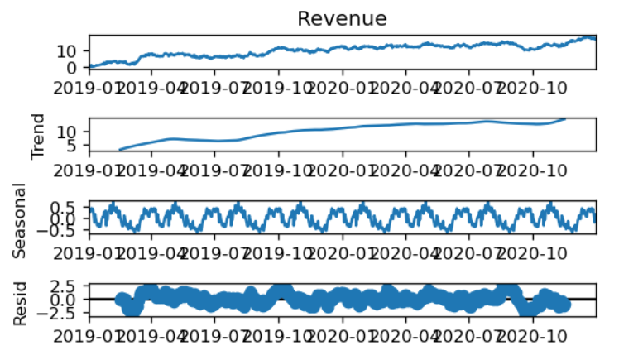
Decomposed Time Series
https://online.stat.psu.edu/stat510/lesson/5/5.1
D1e. Decomposing Time Series means splitting Time Series data into its 3 components (Trend, Seasonality, and Residual) to identify them. It provides a visual summary of the components and helps detect the presence or the lack of these components . You can use the statsmodel seasonal_decompose() function in Python to separate the three components, use the decomp.plot( ) function to plot it out, and use the plt.show to display them. See example output below:
Ex 1: R Code to decompose Time Series
stl <- stl(time_series, s.window = "period") # Perform seasonal decomposition on time series.
autoplot(stl) # Visualize decomposition by observed, trend, seasonal, remainder
Ex 2: R Code to decompose Time Series
train$ma_7 = ma(train$Revenue, order=7)#weekly moving average
train$ma_30 = ma(train$Revenue, order=30)#monthly moving average
count_ma = ts(na.omit(train$Revenue), frequency=30)
decomp = stl(count_ma, s.window="periodic")
deseasonal_cnt <- seasadj(decomp)
plot(decomp)

Slide 39
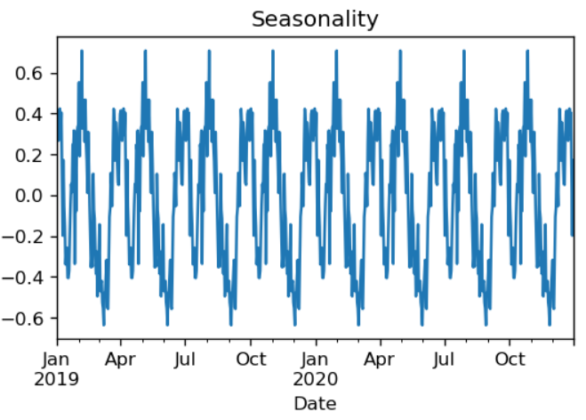
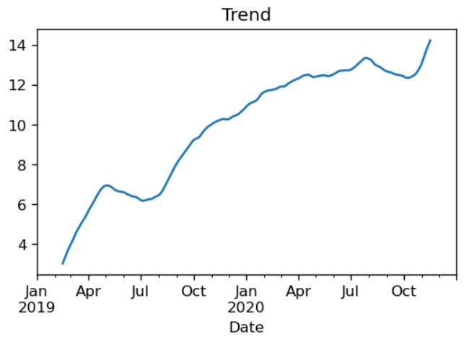
How to Decompose TS
https://www.section.io/engineering-education/time-series-decomposition-in-python/
https://datasciencebeginners.com/2020/11/25/time-series-forecast-and-decomposition-101-guide-python/#How_to_decompose_time_series
https://stackoverflow.com/questions/20672236/time-series-decomposition-function-in-python
Sample Python Code to decompose Time Series Data, plot seasonality, trend, and residual.
Decompose Time Series
decomp = seasonal_decompose(df['Revenue'], period=90 ##Seasonality has 90 days of cyclicality or frequency (repeating pattern for a 90-day fixed period).
plt.show() # Check for seasonality in the data
Plot the Seasonality
plt.title('Seasonality')
decomp.seasonal.plot()
Plot the trend
plt.title('Trend')
decomp.trend.plot()

Slide 40
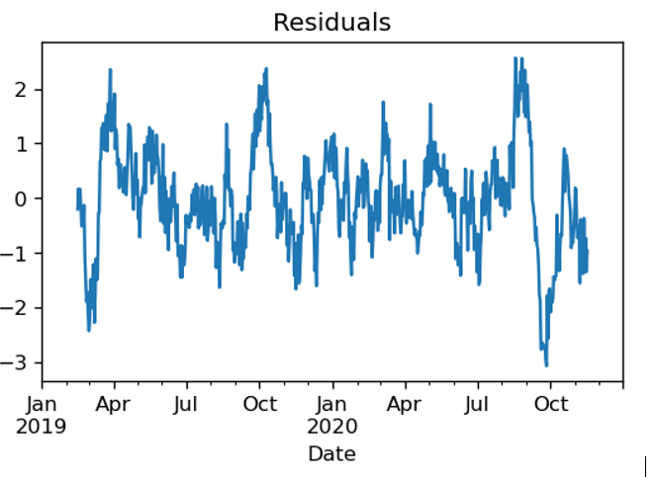
D1f. Residuals. Confirmation of the lack of trends in the residuals of the decomposed series.
The residual of the decomposed time series is the time series after the trend and seasonality components are removed. You can extract the residual from the seasonal_decompose method and then plot it out. See the example output below:
Python Code to plot the residual
plt.title('Residuals')
decomp.resid.plot()
Note: The assumption in time-series forecasting is that the residuals aren’t autocorrelated.
If the residual shows much deviation or variation from the residual line, it may indicate that there is seasonality and further decomposition would be necessary.

Slide 41
Part IV: Model Identification and Analysis Cont’d
D2. Identify an autoregressive integrated moving average (ARIMA) model that accounts for the observed trend and seasonality of the time series data.
To identify a suitable ARIMA model for the time series, you might want to:
Run various order combinations for AR and MA models to find the model with the lowest AIC (Akaike information criterion).
Perform Auto-ARIMA to find the suitable seasonality order or best model fit.
Model Order
Many ways to find the p, d, q. A couple example here.
1. You can run a nested loop to find the p, d, and q values.
P = 1- 3 range; d = 1; q = 1-3 range
2. You can run the ACF, Differencing, and PACF to find the p, d, and q values
p - from PACF
D - from Differencing
q - from ACF

Slide 42
Method 1 for obtaining p, d, q further explained: Find the best AIC and the model order:
You will run a nested loop to find the best AIC and model order (p, d, and q) values.
Output: You will get something like Best AIC: 983.12182 | order: (1, 0)
AIC stands for Akaike information criterion
Based on that, the best model order could be selected, which could look like this: ARIMA(1,1,0)(1,1,0)[90]
Make sure your submission uses auto_arima() to identify an ARIMA model. The arguments to auto_arima() would take into account the observed trend of the time series if the data used are differenced.
The model requires a set of inputs to operate, where:
p is the order of the autoregressive part specifically the lag order AR
d is the degree of first differencing involved – 1 - The value of d should be determined by the KPSS /ADFuller method.
q is the order of the moving average part specifically the size of the average. - MA
A quick way to find p, d, and q values for ARIMA
https://analyticsindiamag.com/quick-way-to-find-p-d-and-q-values-for-arima/

Slide 43
Third Step: Build or create and fit the Time Series Model (ARIMA OR SARIMAX is fine).
SARIMAX is an updated version of ARIMA with seasonal effects and eXogenous factors.
Sample Code:
model = SARIMAX(df, order=(1,1,0),seasonal_order=(1,1,0,90)) # if using original data diffed in the auto_arima step.
SARIMAX(X_train,order=(1,1,0),seasonal_order=(0,1,0,90)) # if using the diffed train data.
results = model.fit()
results.summary()
Final Step: General forecast
The KPSS or ADFuller test previously determined that the time series data is non-stationary but can be transformed to become stationary through one order of differencing. This data transformation, which would also address the trend and seasonality in the data, can be achieved using the functions below:

Slide 44
# Build ARIMA Model – R Code Example
time_series_diff <- diff(time_series, differences = 1) # Apply difference of 1 to time series
ggtsdisplay(time_series_diff) # Visually demonstrate stationarity of adjusted time series
Identifying the orders of AR or MA terms:
https://people.duke.edu/~rnau/411arim3.htm
Identifying ARIMA model using the differenced time-series data https://people.duke.edu/~rnau/411arim2.htm
Sample R Code
auto.arima(training, seasonal = T) # Automate parameter selection
fit <- Arima(training, order = c(1,1,0)) # Model using automated parameter
summary(fit) # Run summary statistics on model checkresiduals(fit) # Review residual pattern

Slide 45
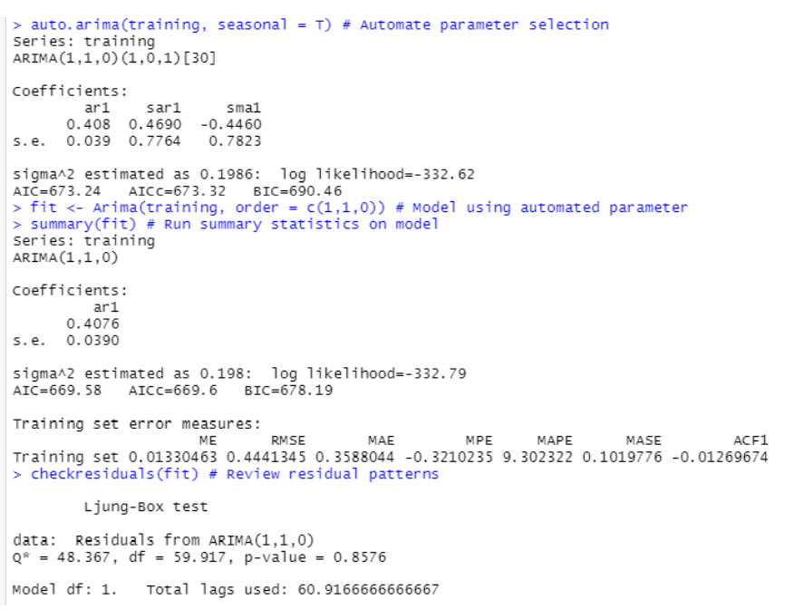
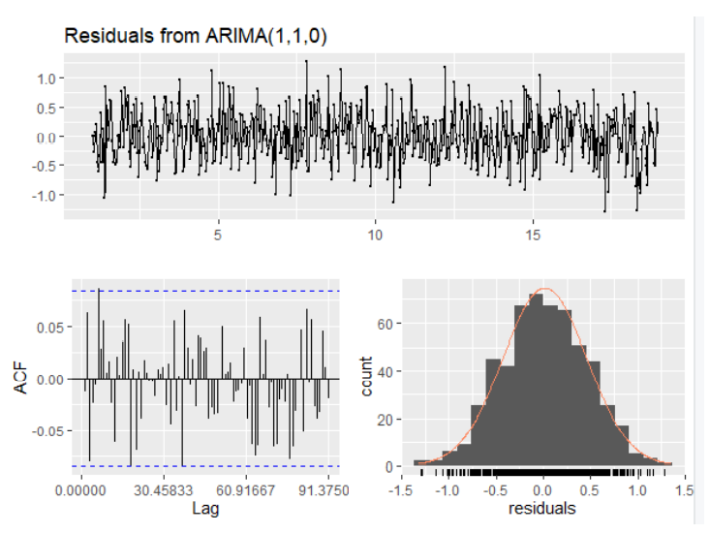
Below are Sample codes in R and their outputs from the ARIMA model that will be used to forecast revenue
Sample R Code
auto.arima(training, seasonal = T) # Automate parameter selection
fit <- Arima(training, order = c(1,1,0)) # Model using automated parameter
summary(fit) # Run summary statistics on model checkresiduals(fit) # Review residual pattern

Slide 46
D3. Forecasting using ARIMA Model - Perform a forecast using the derived ARIMA model identified in part D2.
Steps to follow:
Forecast: Generate a revenue forecast for the company for the next say 90, 180, etc. days. Forecast the revenue not the daily changes in revenue. Do as follows:
Forecast using the model,
Plot(forecast) to visualize forecast based on training data
Add testing data points for comparison
Evaluate: You might want to evaluate the model by comparing the model predictions with the test set.
The derived ARIMA model will be programmed to forecast future revenue values.
The forecast length could be set to 30 days or more, and the predicted pattern could be compared against the testing data set.
The p-values for Ljung-Box statistics will also be provided to assist with model evaluation.
The forecast needs to relate to the line graph visualizing the realization of the time series in part C1 and not to a 1st order difference in the revenue.
Example Python Code to forecast:
diff_forecast = results.get_forecast(steps=180)
mean_forecast = diff_forecast.predicted_mean
confidence_intervals = diff_forecast.conf_int()
lower_limits = confidence_intervals.loc[:,'lower Revenue']
upper_limits = confidence_intervals.loc[:,'upper Revenue']
Example R Code to forecast:
forecast <- forecast(fit, h = 183) # Forecast using model
plot(forecast) # Visualize forecast based on training data
lines(testing) # Add testing data points for comparison
Box.Ljung.Test(forecast) # V Visualize p-values for Ljung-Box statistics

Slide 47
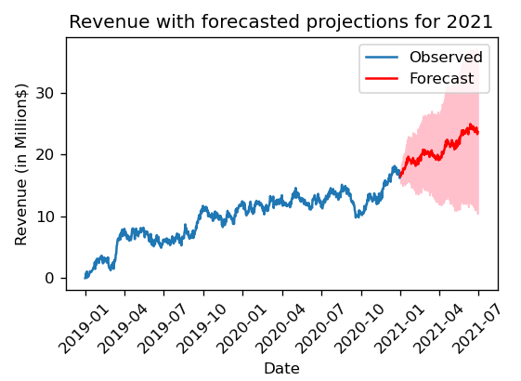
Note:
Build the ARIMA model on the Stationary Training Data
Fit the model on the Stationary Training Set.
Forecast on both the Train set and the Test Set
Evaluate on the Test Set
Difference between forecast and Prediction
Prediction refers to estimate at future data in general
Forecast refers to estimate at a specific future point in time
Evaluation Feedback on D3
The model used for the forecast is not the model identified in D2; it is missing the drift term identified in auto.arima().
Meaning: When evaluation reruns your auto-arima code, the output is different from what you have. This could mean that you created multiple models and named them all the same, or you built two models, the output of the first model is provided, but the second model is used to provide the estimates. In that case, you will need to delete one and keep the one you used for the prediction and your problem will be solved.

Slide 48
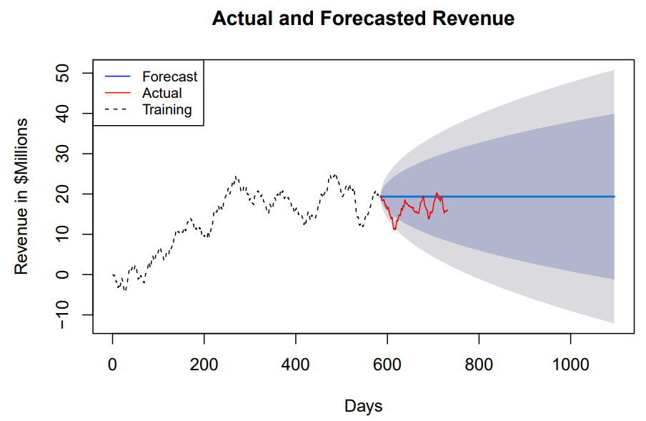
D3: More Example in R
With the arima model selected and fitted, it can now be used to forecast into the future.
The forecast length will be 511 days, to cover the test data set and the next fiscal year.
(3.6 The Forecast Package in R | Forecasting, n.d.)
forecast <-forecast(fit, h = 511)
The forecast is now plotted for visual interpretation, and the test data is superimposed on the graph. The test data is generally within the 80% or 95% percent confidence intervals of the forecast.
plot(forecast, main = "Actual and Forecasted Revenue", ylab = "Revenue in $Millions", xlab = "Days", lty = 2)
lines(test, col = "red")
legend("topleft", legend = c("Forecast","Actual","Training"), col=c("blue", "red","black"), lty = c(1,1

Slide 49
D4. Provide the output and calculations of the analysis you performed. Provide as follows:
Codes to make and validate stationarity
Code for autocorrelation plots (ACF & PACF)
Code for using SARIMAX or whatever to generate seasonal model.
Provide the model summary.
Predictions on out-of-model data (future dates).
D5. Provide the code used to support the implementation of the time series model.
Provide as follows: Basically, codes you used in D3 and D4.
A copy of the Jupyter notebook used to develop and run the ARIMA model.
Key code sections used for implementing the time series model.
Code for splitting the data into training and test sets.
Code used to identify the model order for AR, MA, and seasonality using ACF and PACF plots.
Code for running the SARIMAX model using different model orders to find the best model with the lowest AIC score.
ACF and PACF
Code to validate the model on test data
Etc.

Slide 50
Part V: Data Summary and Implications
E. Summarize your findings and assumptions, including the following points:
1. Discuss the results of your data analysis, including the following:
E1a - the selection of an ARIMA model
To identify a suitable ARIMA model, you will first generate the ACF and PACF. Then run various order combinations for AR and MA to find the model with the lowest AIC score. Show the code and the graph.
E1b - the prediction interval of the forecast
The prediction interval of the forecast is 1 day. Our TM data is a 2-year daily revenue. Therefore, ARIMA model identifies the correlations and seasonality to predict revenue at a day interval.
E1c - a justification of the forecast length
For a 2-year daily revenue data, TM can only forecast up to 1 year of future revenue. Predictions earlier than 1 year will even be more accurate. Long term predictions will require more historical data.

Slide 51
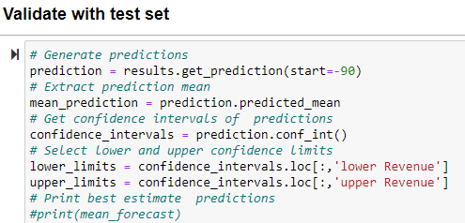
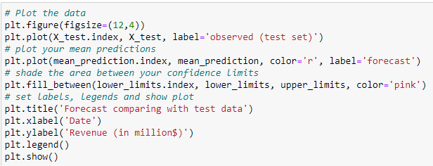
E1d - the model evaluation procedure and error metric.
Model evaluation procedure may include the fact that you created and fitted ARMA(p, q) model. You selected model with the best AIC. You performed Auto-Arima to find the suitable seasonal order. In terms of error metric, you can discuss the numbers for the mean square error (MSE), root mean squared error (RMSE), and the mean absolute error (MAE) as applicable. If the error metrics are so low and so close to 0, you can conclude that the error rates are low given the number of observations in the data.
You need to calculate the errors on the In-sample or resubstituting data compared to the test (out-of-sample or generalization) set.
E2. Provide an annotated visualization of the forecast of the final model compared to the test set.
Here you would want to compare your model predictions with the test set and show the graph differently or on the same plot. The graph should have confidence intervals, labels, legends, or notes that explain it. Sample Code in Python

Slide 52
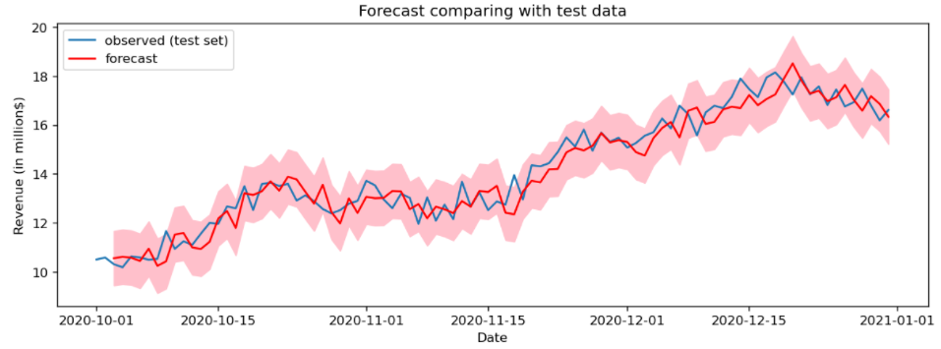
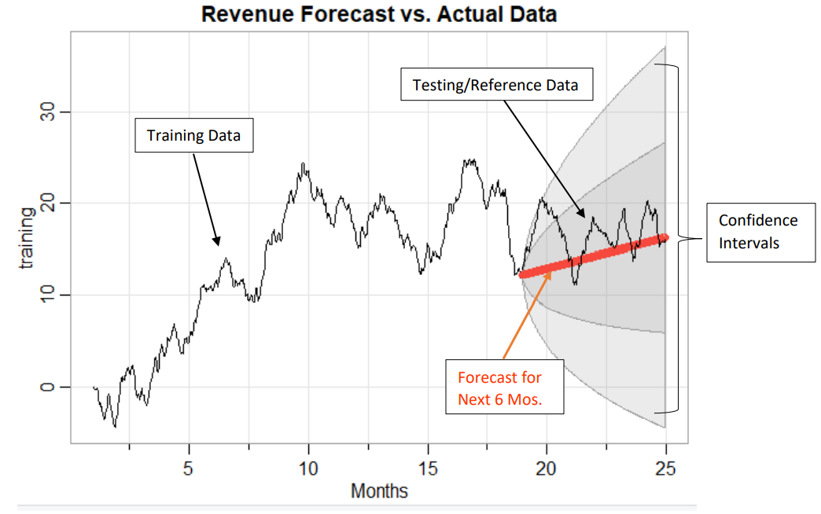
Example 1
Sample Code in R
Sarima.for(training, n.ahead = 350, 2, 1, 0, plot.all = T, xlab = “Months”,
main = “Revenue Forecast vs. Actual Data”) # Forecast with new model
Example 2
The submission compares the last fitted values with the series actuals. The plot shows a true out-of-sample comparison of a model trained only with the training set and predicted into the test-set horizon, compared with the test-set actuals.

Slide 53
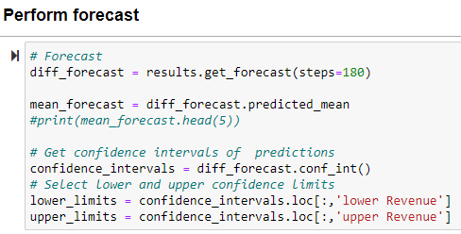
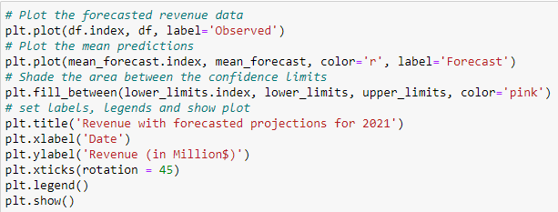

Slide 54
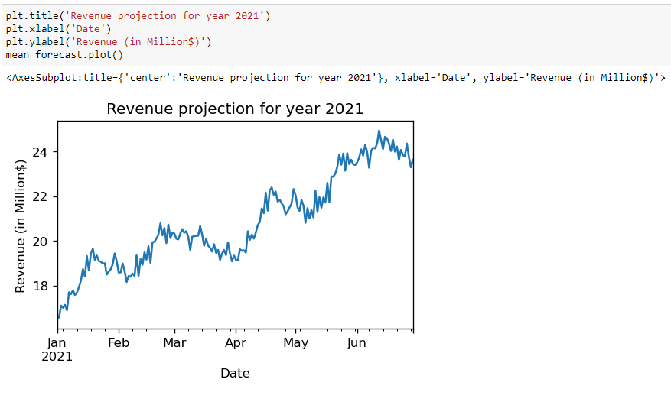
Revenue projection of a non-stationary data

Slide 55
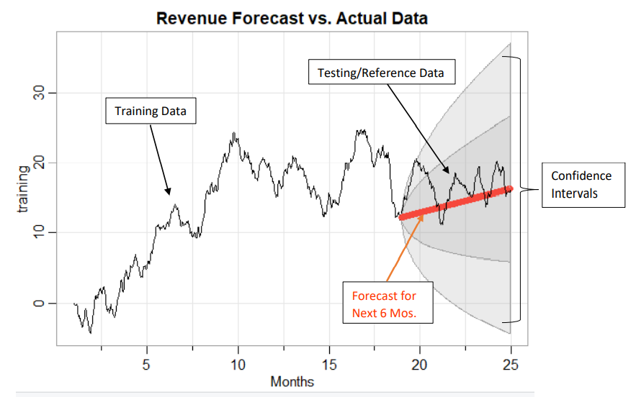
The annotated visualization of the forecast of the final model compared to the test set.
E3. Recommend a course of action based on your results. What insight from your analysis will you provide to the Stakeholders or the Business?
Ex 1. Time series has a good performance accuracy to forecast 90 days’ future revenue.
Ex 2. Stakeholders should continue to work toward reducing readmission rates to decrease payment reductions from penalties imposed by the program while growing confidence in the patients.
Ex 3. Shorter time forecasts are easier and more accurate to predict than long-term with 2-year data.
Ex 4. ARIMA model can perform a forecast with a prediction interval of 1 day and a forecast length of 90-180 days. Using the model company can forecast the revenue projection for the next 2 quarters (180 days).
Ex 5. The company can use this forecast to plan for network capacity expansion for its customers.

Slide 56
Part VI: Reporting
F. Create your report from part E using an industry-relevant interactive development environment (e.g., an R Markdown document, a Jupyter Notebook, etc.). Include a PDF or HTML document of your executed notebook presentation.
Say if you used the Jupyter Notebook or R Markdown as your IDE for coding. Attach a PDF or HTML of your entire code with outputs with your submission. For example, if you wrote your code in the R Markdown environment, you can export your code (.rmd file) to a pdf or HTML and submit the file alongside your work. If you wrote your code in Python, download your Jupyter Notebook as pdf or HTML and submit it alongside your work. The following links show how to export your Jupyter Notebook to html or PDF.
https://jupyterlab.readthedocs.io/en/stable/user/export.html
How to Export Jupyter Notebooks into Other Formats - Mouse Vs Python (pythonlibrary.org)
G. List the web sources used to acquire data or segments of third-party code to support the application. Example:
https://access.wgu.edu/ASP3/aap/content/f9ck5mr9dk4fcd054klw.html (WGU, n.d)
https://campus.datacamp.com/courses/arima-models-in-python (Datacamp, n.d).
https://github.com/krishnaik06/ARIMA-And-Seasonal-ARIMA/blob/master/Untitled.ipynb
(Naik, 2020).

Slide 57
H. Acknowledge sources, using in-text citations and references, for content that is quoted, paraphrased, or summarized.
If the evaluator commented that the reference list citations are presented with limited bibliographical detail. See what it means below.
The lack of bibliographical details means that the reference (s) even though listed did not have the minimal set of elements needed to identify that source. For a Journal article, you might need: name of the author(s), year of publication, title, journal name, volume, issue number, pagination, URL, etc.
Journal Example:
Debbie, T., Timothy, K. J., & Mark, F. N. (2007). IT project risks: The project management professional perspective. The Journal of Computer Information Systems, 1-5.
Web Example:
Brownlee, J. (2018). Metrics to evaluate machine learning algorithms in Python. Retrieved 01/03/2022 from https://machinelearningmastery.com/metrics-evaluate-machine-learning-algorithms-python

Slide 58
Q & A
I have been running the model on non-diffed data. Is that correct? Not sure what you meant by “running model” I assumed that to mean building the model. Running (building) model on non-diffed data is not correct. You want to build your model on the cleaned (diffed) dataset. That is the data set after you diffed your data for stationarity. The diffed data is the data set without Trend and Seasonality. (Split into train and test on the original non-diffed data set). If you split the differenced data set you do not have to diff again when training the model.
2. I fit the model using the train data set. Is this correct? Yes, that is correct.
3. Do I need any refitting of the model for the rest of the code? No further refitting is required except you evaluated your ARIMA model to be a poor fit. In that case, you will need to adjust the parameters in your autoregressive order (p) and produce a new, better-fitting model.

Slide 59
Code Errors
IndexError in Python
Invalid Index Error when attempting to plot the forecast.
This error occurs when an attempt is made to access an item in a list at an index that is out of bounds meaning trying to access an item at an index outside this range,
The problem usually is that the student was indexing the original data instead of the train data in the forecast or vice versa. Fix by referencing the correct dataset.

Slide 60
Task 1
REFERENCE SECTION

Slide 61
Time Series - R
Hyndman, R. J., & Athanasopoulos, G. (2021). Forecasting: Principles and Practice. Retrieved from https://otexts.com/fpp2/ or https://robjhyndman.com/hyndsight/fpp/
Arima Modelling in R: https://otexts.com/fpp2/arima-r.html
Time Series Modeling in R: https://www.analyticsvidhya.com/blog/2015/12/complete-tutorial-time-series- modeling/
Book: Data Camp Course ARIMA Models in R
Time Series Analysis and it's Applicationshttps://www.stat.pitt.edu/stoffer/tsa4/tsa4.pdf
Boshnakov. G. Halliday. J. (2022). Simulation and Prediction with Seasonal ARIMA Models.
CRAN. 2022. https://cran.r-project.org/web/packages/sarima/sarima.pdf
Rajbhoj, A. (Apr 26, 2019). ARIMA simplified. Retrieved 11/7/2022 from https://towardsdatascience.com/arima-simplified-b63315f27cbc
R Code for Two Examples in Lesson 1 & 2: https://online.stat.psu.edu/stat510/lesson/1/1.3

Slide 62
Time Series - R
Spec.ar function in R can be used to Estimate Spectral Density of a Time Series from AR Fit. The following links may provide some insights.
https://stat.ethz.ch/R-manual/R-devel/library/stats/html/spec.ar.html
https://www.rdocumentation.org/packages/stats/versions/3.6.2/topics/spec.ar
CRAN. 2022. https://cran.r-project.org/web/packages/sarima/sarima.pdf CFI. Autocorrelation. Corporate Finance Institute. Accessed June 2022. https://corporatefinanceinstitute.com/resources/knowledge/other/autocorrelation
Overview of Time Series Characteristics: https://online.stat.psu.edu/stat510/lesson/1/1.1
Decomposition Models in R: https://online.stat.psu.edu/stat510/lesson/5/5.1
NIST. Stationarity. National Institute of Standards and Technology. Accessed June 2022
https://www.itl.nist.gov/div898/handbook/pmc/section4/pmc442.htm#:~:text=A%20com
mon%20assumption%20in%20many,do%20not%20change%20over%20time
Free eBook - Data Camp course Forecasting Using R: https://robjhyndman.com/hyndsight/fpp
Rob J Hyndman Book Link of TM in R: https://robjhyndman.com/hyndsight/fpp/

Slide 63
Time Series - R Cont’d
Arima Modelling in R: https://otexts.com/fpp2/arima-r.html
Time Series Modeling in R: https://www.analyticsvidhya.com/blog/2015/12/complete-tutorial-time-series-modeling/
S&S (Feb. 2019) Introduction to AR, MA, and ARMA Models. https://maryclare.github.io/atsa/content/notes/notes_3.pdf
PennState. (n.d). Estimating the spectral density. https://online.stat.psu.edu/stat510/lesson/12/12.1
https://cran.r-project.org/web/packages/textclean/index.html
Identifying the orders of AR or MA terms:
https://people.duke.edu/~rnau/411arim3.htm
Identifying ARIMA model using the differenced time-series data https://people.duke.edu/~rnau/411arim2.htm
Brownlee, J. (2016, Dec. 21). How to Use and Remove Trend Information from Time Series Data in Python. Machine

Slide 64
Time Series - Python
Learning Mastery. https://machinelearningmastery.com/time-series-trends-in-python/#:~:text=A%20time%20series%20with%20a%20trend%20is%20called,the%20dataset%20is%20said%20to%20be%20trend%20stationary
(Datacamp, n.d). https://app.datacamp.com/learn/courses/time-series-analysis-in-python
The above is an official Datacamp Resource, will be added to custom track soon. In the meantime, students should be able to access the course via their login account. Send only this resource to students.
Datacamp. (n.d). ARIMA models in python. https://campus.datacamp.com/courses/arima-models-in-python
(Datacamp, n.d). https://campus.datacamp.com/courses/arima-models-in-python
Aronso, L. (Nov. 2, 2019). ARIMA Modeling and Train/Test Split. Retrieved from
https://laurenliz22.github.io/arima_modeling_and_train_test_split
ARIMA: https://analyticsindiamag.com/quick-way-to-find-p-d-and-q-values-for-arima/

Slide 65
Time Series – Python Cont’d
Sangarshanan (Oct 03, 2018) “Timeseries Forecasting ARIMA models “ Retrieved July 26,2021 from
https://towardsdatascience.com/time-series-forecasting-arima-models-7f221e9eee06
Hyndman, R.J., & Athanasopoulos, G. (2018) “Forecasting: principles and practice”
2nd edition, OTexts: Melbourne, Australia Retrieved July 26,2021 from https://otexts.com/fpp2/stationarity.html
Spectral Density in Python: https://docs.scipy.org/doc/scipy/reference/generated/scipy.signal.periodogram.html
SciPy Documentation:
https://docs.scipy.org/doc/scipy/reference/generated/scipy.signal.periodogram.html
ARIMA in Python: https://app.datacamp.com/learn/courses/arima-models-in-python
https://medium.com/auquan/time-series-analysis-for-finance-arima-models-acb5e39999df
Scipy, (n.d). https://docs.scipy.org/doc/scipy/reference/generated/scipy.signal.periodogram.html
Jebb Andrew T., Tay Louis, Wang Wei, Huang Qiming (09 June 2015) “Time series
analysis for psychological research: examining and forecasting change” Retrieved July 26,2021 from https://www.frontiersin.org/articles/10.3389/fpsyg.2015.00727/full

Slide 66
Task 1 – Time Series - Python Cont’d
How to Decompose TM Data in Python: https://machinelearningmastery.com/decompose-time-series-data-trend-seasonality/
Educative. (n.d). What is autocorrelation in Python? https://www.educative.io/edpresso/what-is-autocorrelation-in-python
Medium. (2020, Jun 20). What is time series decomposition and how does it work. https://towardsdatascience.com/what-is-time-series-decomposition-and-how-does-it-work-9b67e007ae90
Naik, K. (2020, Mar 18). Forecasting future sales using ARIMA and SARIMAX [Video]. YouTube. https://www.youtube.com/watch?v=2XGSIlgUBDI
Naik, (2020). https://github.com/krishnaik06/ARIMA-And-Seasonal-ARIMA/blob/master/Untitled.ipynb
(WGU, n.d). https://access.wgu.edu/ASP3/aap/content/f9ck5mr9dk4fcd054klw.html
https://www.section.io/engineering-education/time-series-decomposition-in-python/
https://datasciencebeginners.com/2020/11/25/time-series-forecast-and-decomposition-101-guide-python/#How_to_decompose_time_series
https://stackoverflow.com/questions/20672236/time-series-decomposition-function-in-python

Slide 67



